Slide 1
Faces of Medicaid Chartbook
Examining Children’s Behavioral Health Service Utilization and Expenditures
Cite: S. Pires, K. Grimes, T. Gilmer, K. Allen, R. Mahadevan. Faces of Medicaid: Examining Children’s Behavioral Health Service Utilization and Expenditures.” Center for Health Care Strategies. December 2013.
Access the full report: http://www.chcs.org/resource/examining-childrens-behavioral-health-service-utilization-and-expenditures-3/
Made possible through support from the Annie E. Casey Foundation, The Commonwealth Fund, and the Substance Abuse and Mental Health Services Administration.
© Center for Health Care Strategies 2014

Slide 2
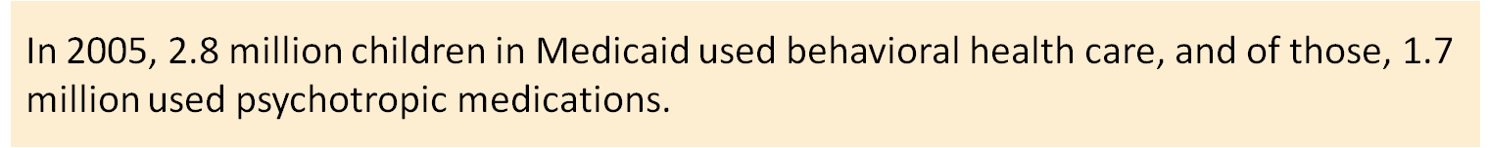
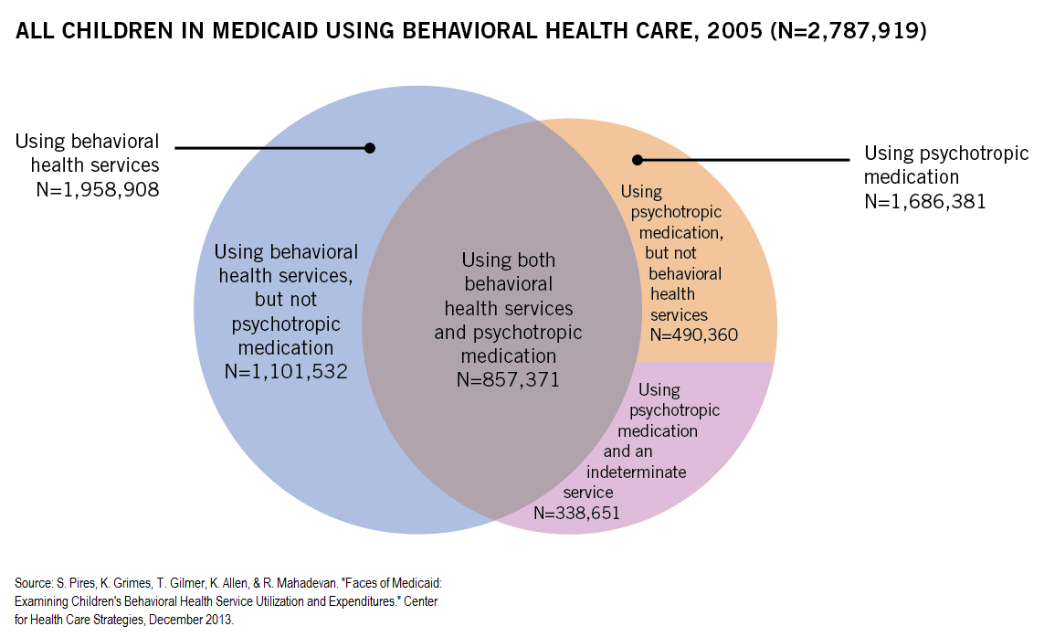

Slide 3
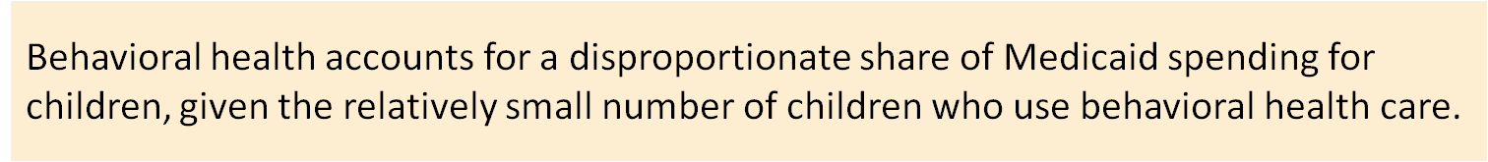
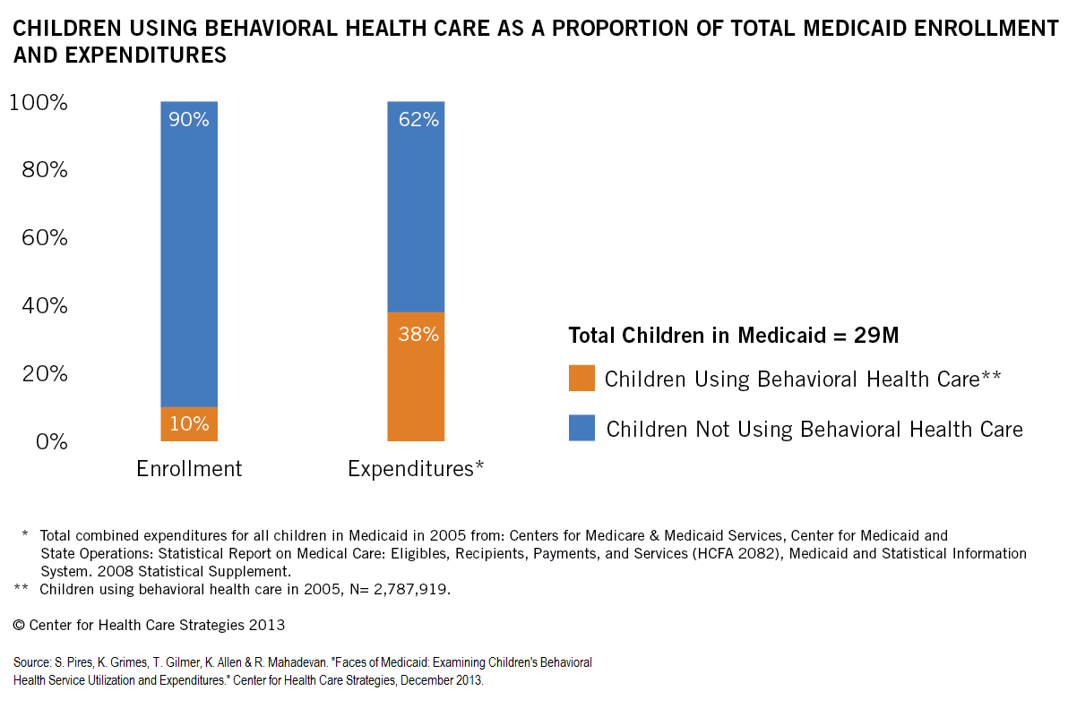

Slide 4
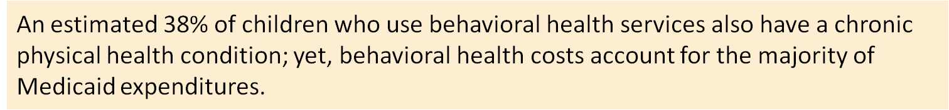
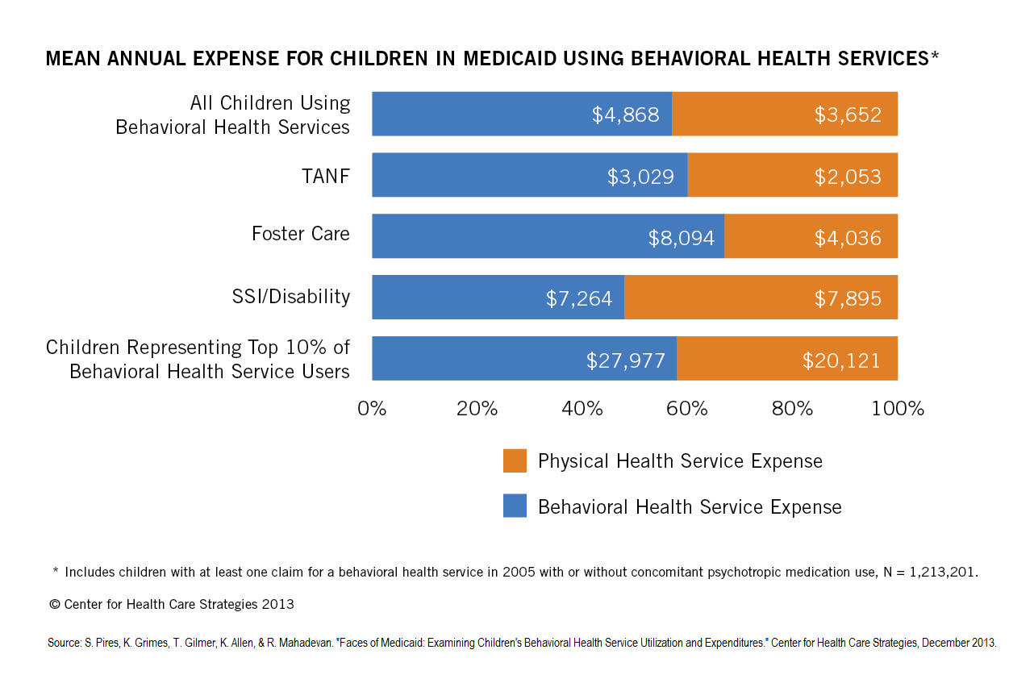

Slide 5
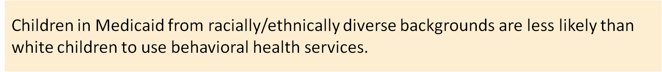
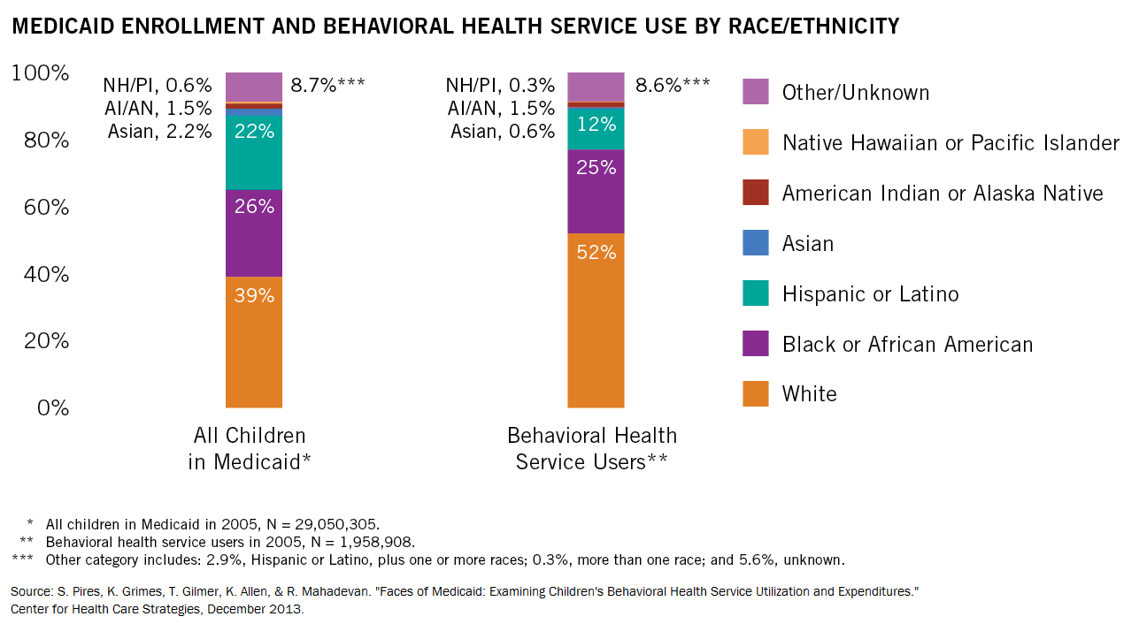

Slide 6
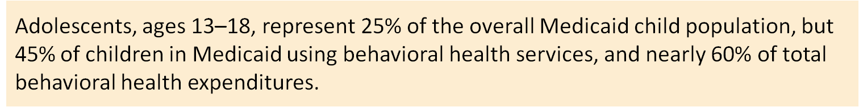
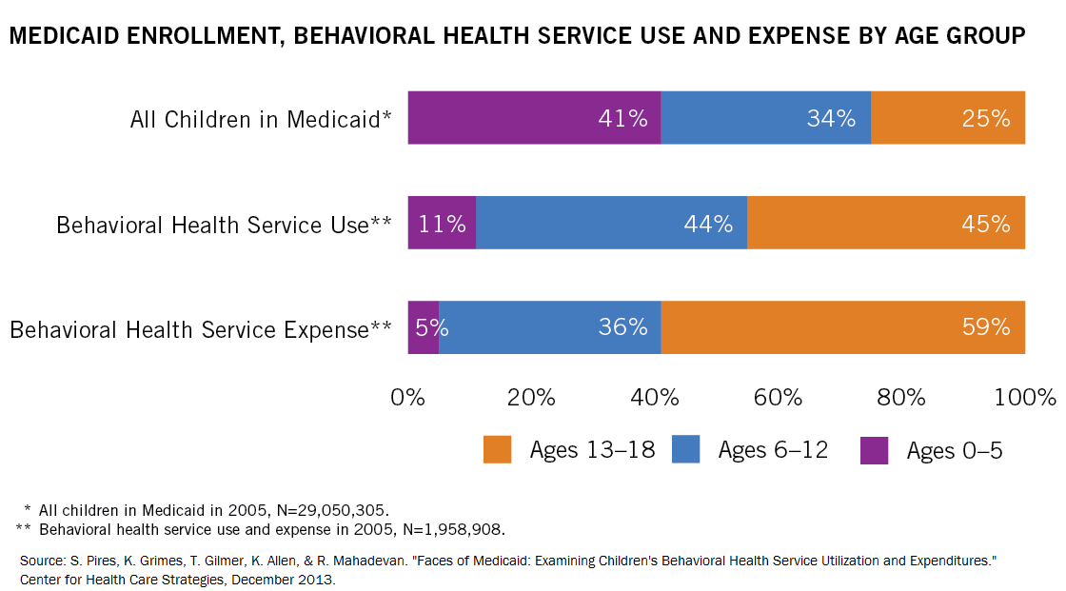

Slide 7
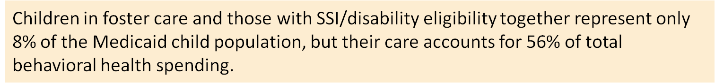
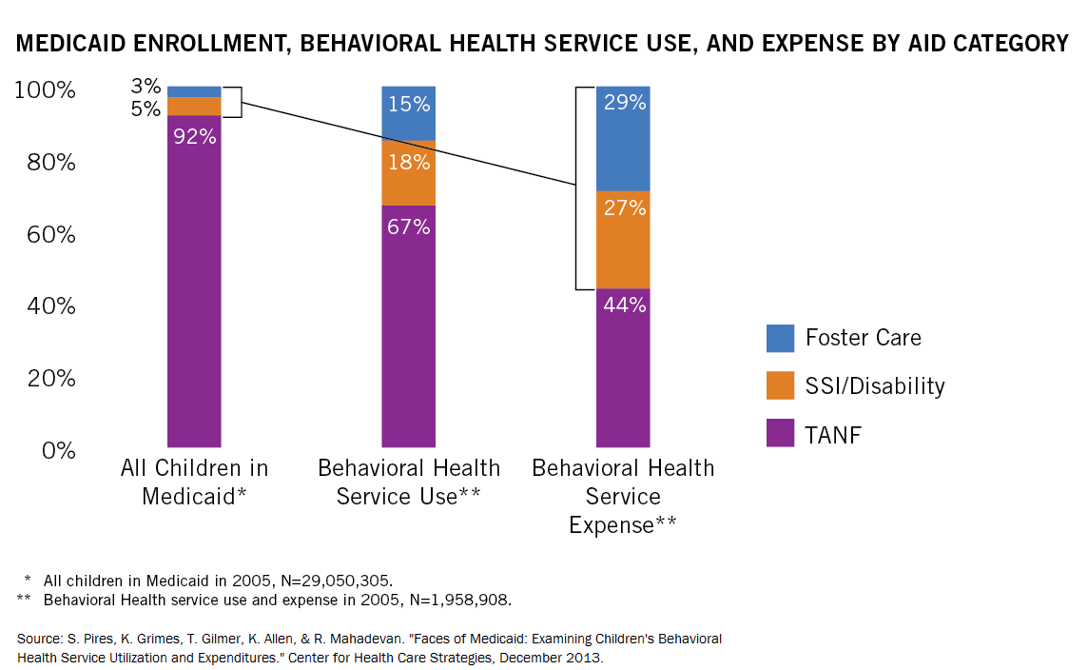

Slide 8
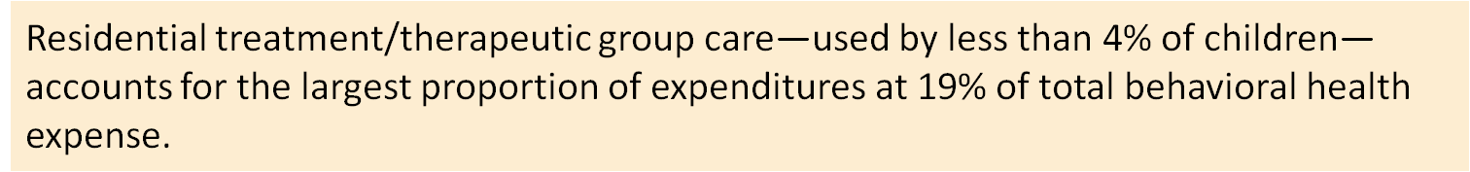
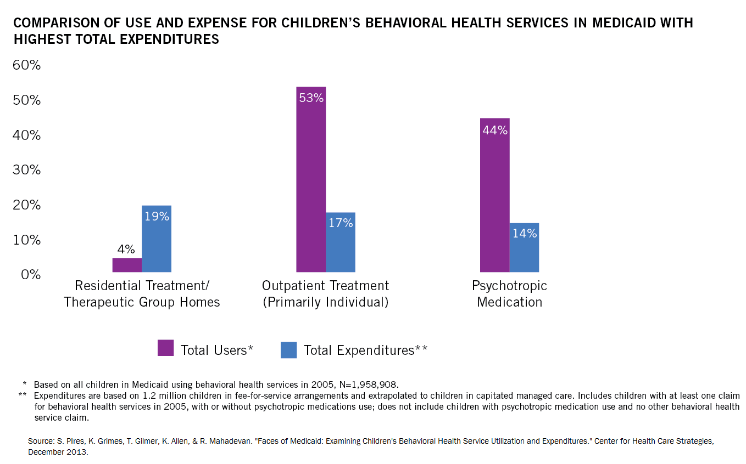

Slide 9
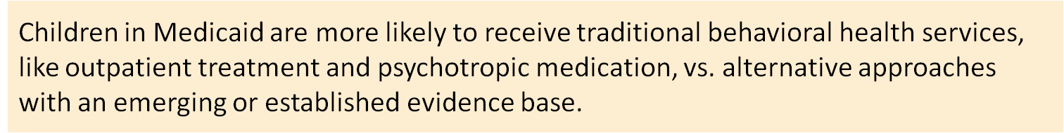
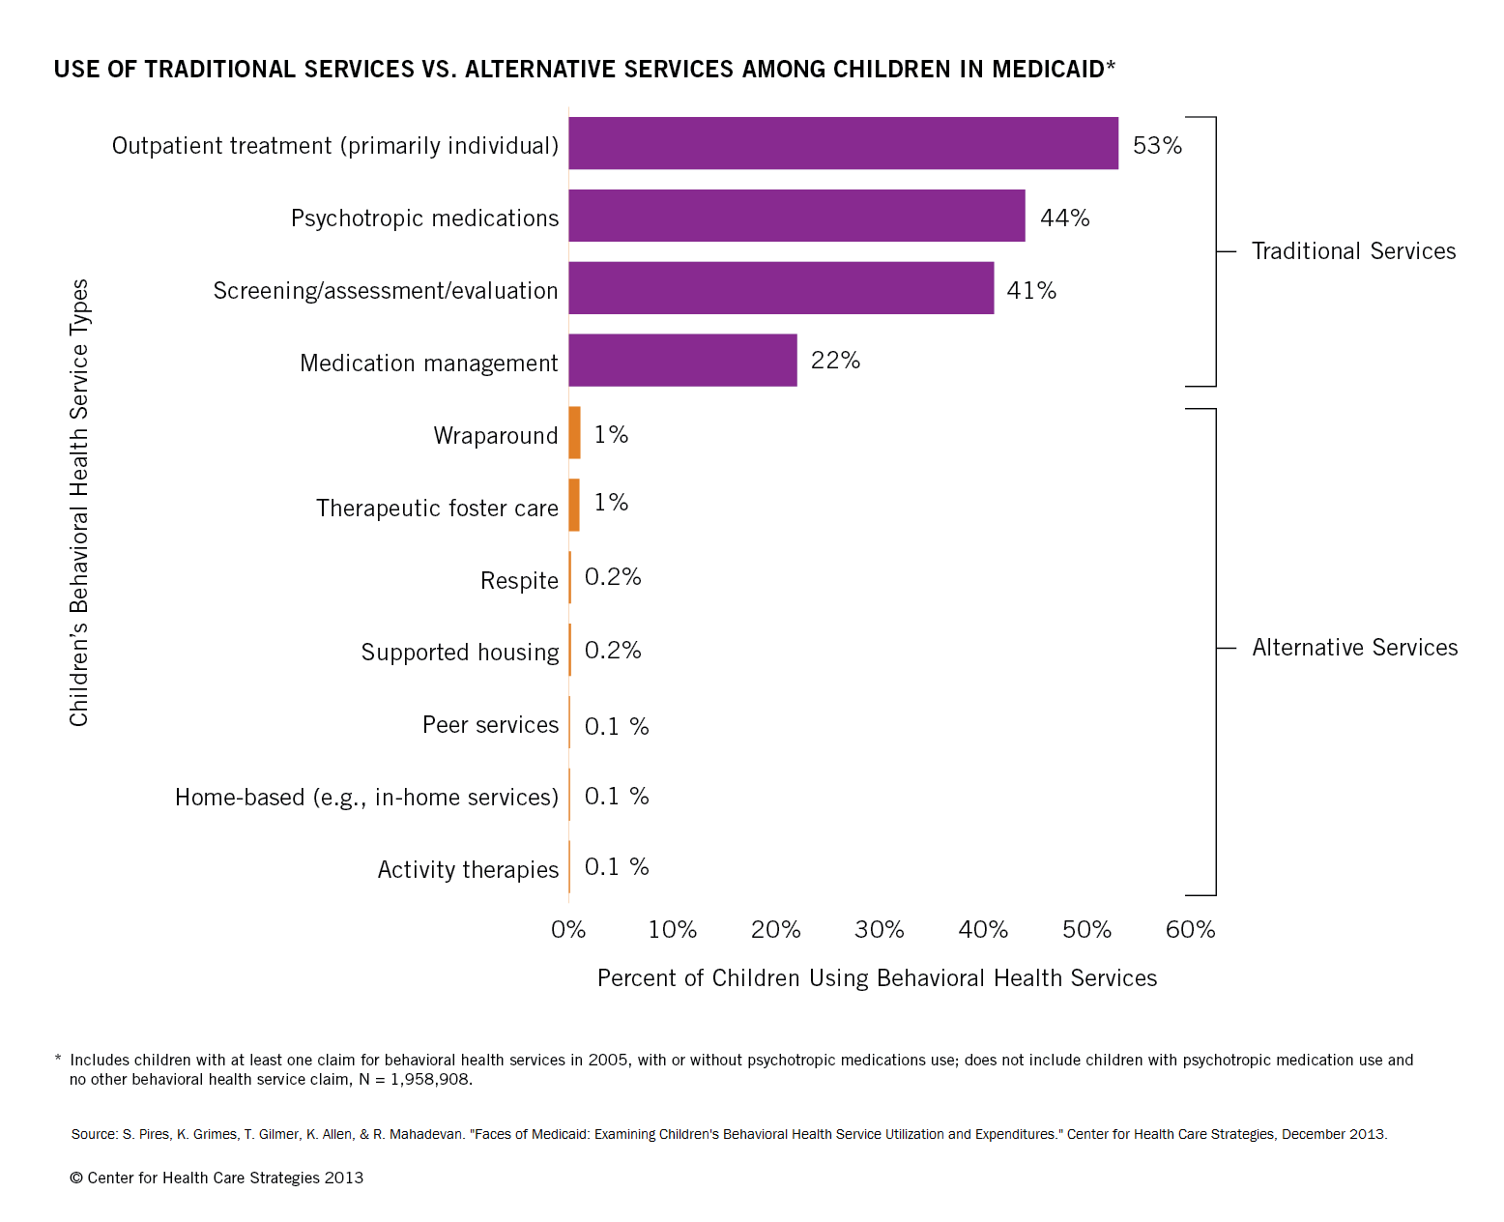

Slide 10
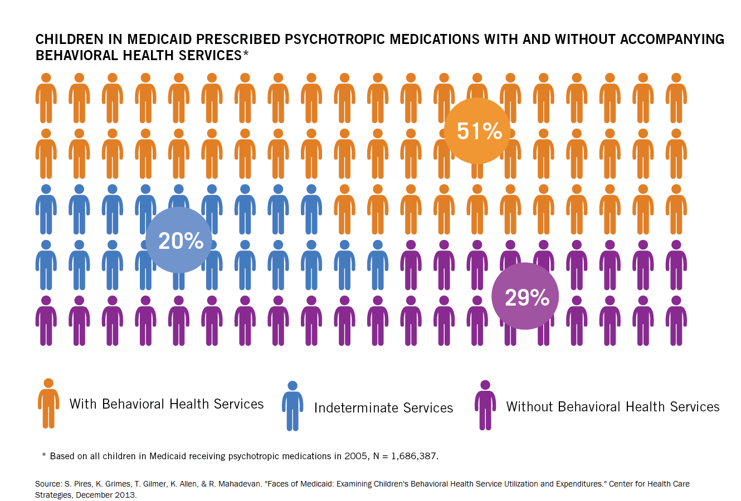

Slide 11
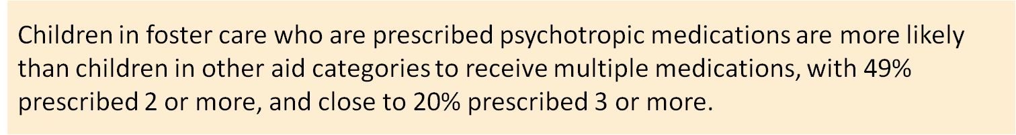
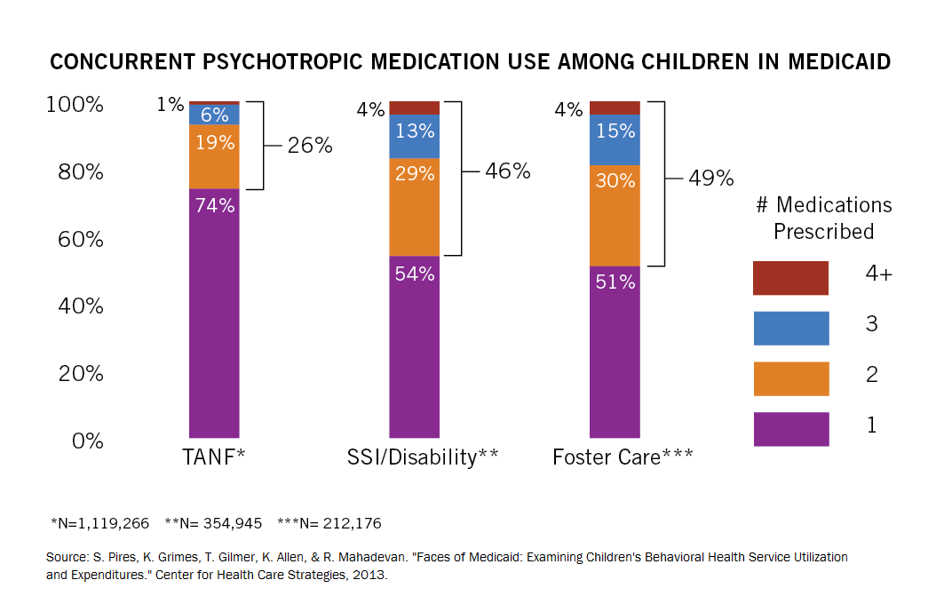

Slide 12
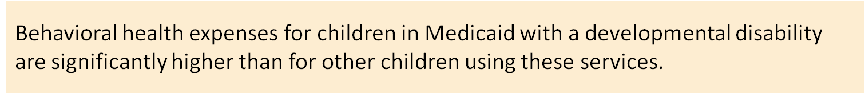
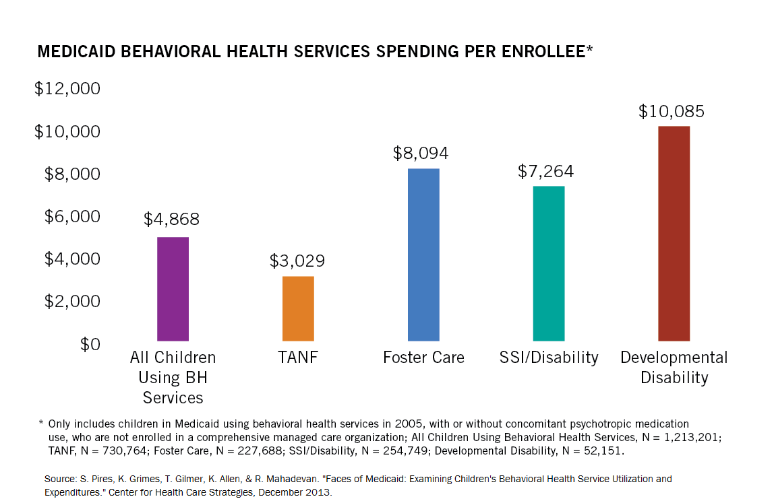

Slide 13
Visit CHCS.org to…
Download practical resources to improve access, quality, and cost-effectiveness in publicly-financed health care
Subscribe to CHCS e-mail updates to learn about new programs and resources
Learn about cutting-edge efforts to improve care for Medicaid’s highest-need, highest-cost beneficiaries
www.chcs.org

