Slide 1
Equity-Centered Strategies to Improve Care for People Experiencing Homelessness: Lessons from Kings and Tulare Counties
CROSS-SECTOR PARTNERSHIPS TO SUPPORT PEOPLE EXPERIENCING HOMELESSNESS
September 29, 2023, 11:00 – 12:00 pm PT
Made possible by the California Health Care Foundation
Notes:
Hello and welcome to today’s Center for Health Care Strategies webinar: Equity-Centered Strategies to Improve Care for People Experiencing Homelessness: Lessons from Kings and Tulare Counties, made possible through support from the California Health Care Foundation.
I am Shannon Mead, PO at the Center for Health Care Strategies and I will be kicking off today’s webinar. This webinar is part of a series that focuses on building cross-sector partnerships between health care and homeless services organizations to support people who are experiencing homelessness. This webinar is informed by the work of a project called Partnerships for Action, also supported by CHCF, which I will share more about in a few slides.
Before I review today’s agenda– one quick housekeeping item - at the end of today's session, a brief online evaluation will pop-up on your screen. Your feedback is very important to us and we hope you will take a moment to complete this survey.

Slide 2
Agenda
Welcome and Introductions
Perspectives from the Managed Care Plans (MCPs)
Perspectives from the Continuum of Care (CoC)
Facilitated Panel Discussion with Q&A
Notes:
Welcome and Introductions
Hear from the team of organizations working in Kings and Tulare counties in CA who are working to integrate an equity lens into the homelessness system with a focus on the connection to the coordinated entry system,
Pleased to welcome our colleague from the National Health Care for the Homeless Council to provide their perspective on the equity work Kings and Tulare Homeless Alliance is working on and how that relates to what they are observing nationally the homelessness space
Moderated Q&A – encourage you to submit your questions throughout today’s webinar via the Q&A icon. We will address those once we get to that portion of the webinar.

Slide 3
Center for Health Care Strategies
Dedicated to strengthening the U.S. health care system to ensure better, more equitable outcomes, particularly for people served by Medicaid.
Together with our partners, our work advances:
Effective models for prevention and care delivery that harness the field’s best thinking and practices to meet critical needs.
Efficient solutions for policies and programs that extend the finite resources available to improve the delivery of vital services and ensure that payment is tied to value.
Equitable outcomes for people that improve the overall well-being of populations facing the greatest needs and health disparities.
Notes:
CHCS is a nonprofit based in New Jersey that works with stakeholders nationally to strengthen health care services to ensure better and more equitable outcomes, particularly for children and adults served by Medicaid.
Since 1995, we have worked in every state in the nation. We partner with state and federal agencies, health plans, providers, community-based organizations, and consumers to make health care work better for people who face serious barriers to well-being — barriers like poverty, complex health and social needs and systemic racism.
We work to advance:
More effective models for care delivery;
More efficient policy and program design; and across all our work, we focus on
More equitable care and opportunities to address the obstacles that stand in the way of health equity for people facing the greatest disparities.
Customize the transition to how specific program/presentation supports the above goals…

Slide 4
CHCS Approach to Work
We partner with Medicaid stakeholders — including state and federal agencies, managed care plans, providers, community-based organizations and consumers — to promote innovations in health care delivery where they are needed most.
Through our work, we:
Identify and advance best practices
Drive policy improvements with evidence and insights
Develop the capacity and expertise of health care leaders
Provide practical training, technical assistance, and tools
Spread success by connecting peers and experts across sectors
Notes:
Our work with Medicaid stakeholders focuses primarily on five broad strategies to promote innovations in health care delivery where they are needed most.
First and foremost, we are a knowledge organization – we are in the business of identifying and broadly disseminating what is working in the field;
We drive policy improvements by analyzing and distilling evidence and insights to inform state and national policy;
We build leadership capacity. We ensure that health care leaders – at the state, plan, and provider level – have the skills needed to succeed in their roles;
We provide practical training, tailored technical assistance and tools to help implement effective policy at the ground-level; and finally and relevant to today’s event
We spread success by helping peers and experts connect across the country to learn from each other.

Slide 5
Partnerships for Action: California Health Care & Homelessness Learning Collaborative
Goal: Improve care delivery and health and housing outcomes for Californians experiencing homelessness by supporting health care and homeless services organizations partnerships
Made possible by the California Health Care Foundation
Eight cross-sector teams, competitively selected for participation, are piloting collaborative projects and cross-sector partnerships that innovate care delivery for people experiencing homelessness in their communities
Project period: July 2022 – July 2024
Notes:
Talk about the project that is brining us together today –
History of Partnership with Anthem:
KTHA and Anthem share a history of collaboration, driven by a common goal: addressing the housing needs of Anthem members within our region.
The 2019 Pilot Program with HUD Vouchers:
In 2019, KTHA, Anthem, and the Tulare County Public Housing Authority embarked on a pilot program that aimed to lease 45 HUD Mainstream Housing Vouchers. This initiative laid the foundation for our collective efforts.
Challenges in Lease-Up Expenses:
Throughout this journey, KTHA encountered a crucial challenge: securing the necessary funding for housing lease-up expenses. This included critical components such as deposits, application fees, and move-in supplies.
Anthem's Grant Funding Support:
In response to this challenge, Anthem provided vital grant funding specifically allocated to cover these housing-related expenses. This support was pivotal in ensuring that the vouchers could be effectively utilized.
Data Sharing for Targeting Vouchers:
Beyond financial assistance, Anthem's collaboration with KTHA extended to data sharing from the Coordinated Entry System (CES). This collaborative effort enabled the identification of Anthem members experiencing homelessness, allowing for targeted allocation of vouchers.
Renewed Collaboration in 2022 for Holistic Support:
In 2022, Anthem and KTHA renewed their collaboration, placing a renewed emphasis on integrating External Case Management (ECM) and Community Services (CS) into the homelessness system. The core objective is to strengthen the connection between these services and the Coordinated Entry System (CES). Simultaneously, the partnership highlights the importance of providing essential supportive services to households once they secure housing.
Health Net's Inclusion in the Collaborative Effort:
In early 2023, Health Net joined our collaborative effort due to their significant presence and influence in the two counties. Their participation further enhances our team's capacity to address housing and health equity, marking a significant milestone in expanding the reach and impact of our shared initiatives.

Slide 6
Meet Today’s Presenters
Nai Kasick
Vice President, Medi-Cal Lead
HealthNet
Miguel Perez
Program Manager- Regional Housing Strategy
Anthem Blue Cross
Leticia Hinojosa
Co-Director
Kings Tulare Homeless Alliance
Melissa McCarthy
Racial Equity Coordinator
Kings Tulare Homeless Alliance
Katie League
Behavioral Health Manager
National Health Care for the Homeless Council

Slide 7
Integrating More Equitable Practices into Policies and Procedures
Setting the table by the California Department of Health Care Services to prioritize Health Equity
Importance of establishing Health Equity leadership
Intersection of Health Equity Policy and Practice
Notes:
Nai-
Setting the Table for Health Equity:
This overarching theme explores how the California Department of Health Care Services is prioritizing health equity in its initiatives.
Leadership for Equity:
Delving into the importance of dedicated leadership in advancing health equity efforts.
Integrating Equity into Policies and Practices:
This discussion emphasizes the practical integration of equitable practices into our organizational policies and procedures.

Slide 8
Integrating More Equitable Practices into Policies and Procedures (cont.)
Strategic Approaches to Equity
Equity in Funding Initiatives
HealthCare's Expanding Role in Social Drivers of Health
Collaboration for Success
Notes:
Miguel-
1. Strategic Approaches to Equity:
Exploring the development and implementation of strategic plans that drive equity in our operations.
2. Equity in Funding Initiatives:
Highlighting the role of funding strategies in reducing disparities in health outcomes.
3. Healthcare's Expanding Role in Social Determinants:
Examining how healthcare intersects with housing and other social determinants to address holistic well-being.
Collaboration for Success:
Emphasizing the value of partnerships with external providers to advance our equity objectives.

Slide 9
Kings/Tulare Homeless Alliance

Slide 10
Continuum of Care (CoC) on Homelessness
Housing and Urban Development (HUD) CoC Notice Of Funding Opportunity (NOFO) Racial Equity Requirements
HUD CoC NOFO has made equity one of its top priorities by giving points in the competition if you can demonstrate: Promoting Racial Equity in Homelessness Response and Promoting Racial Equity in the Local CoC Process.
Data Analysis – All CoCs are encouraged to use a tool to analyze disaggregated Homeless Management Information System (HMIS) data. Ensure the review includes analyses of all program data points with an equity lens.
System Examination - Understand that structural racism permeates all institutions and examine our current systems to locate disparities
Use an intersectional lens, holding multiple identities can increase vulnerability
Implementation
Holding focus groups for clients currently sheltered/unsheltered, enrolled in a program that prioritized people experiencing homelessness, living experience
KTHA Board member with lived experiencing, programmatic rating and ranking committee groups including lived experience
Low barrier shelters, no wrong door approach to enter Coordinated Entry System (CES), in crease in flex funds to pay for client move in costs/arrears, multiple outreach teams to touch Kings and Tulare Counties

Slide 11
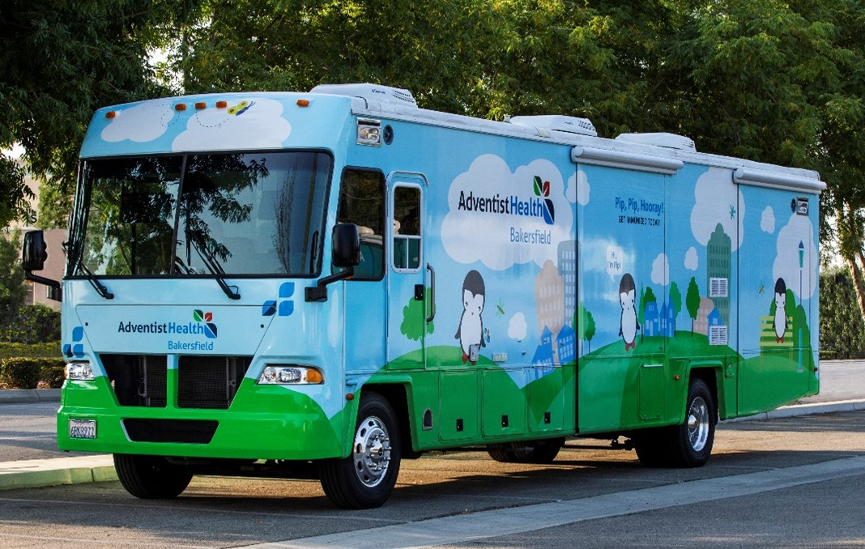
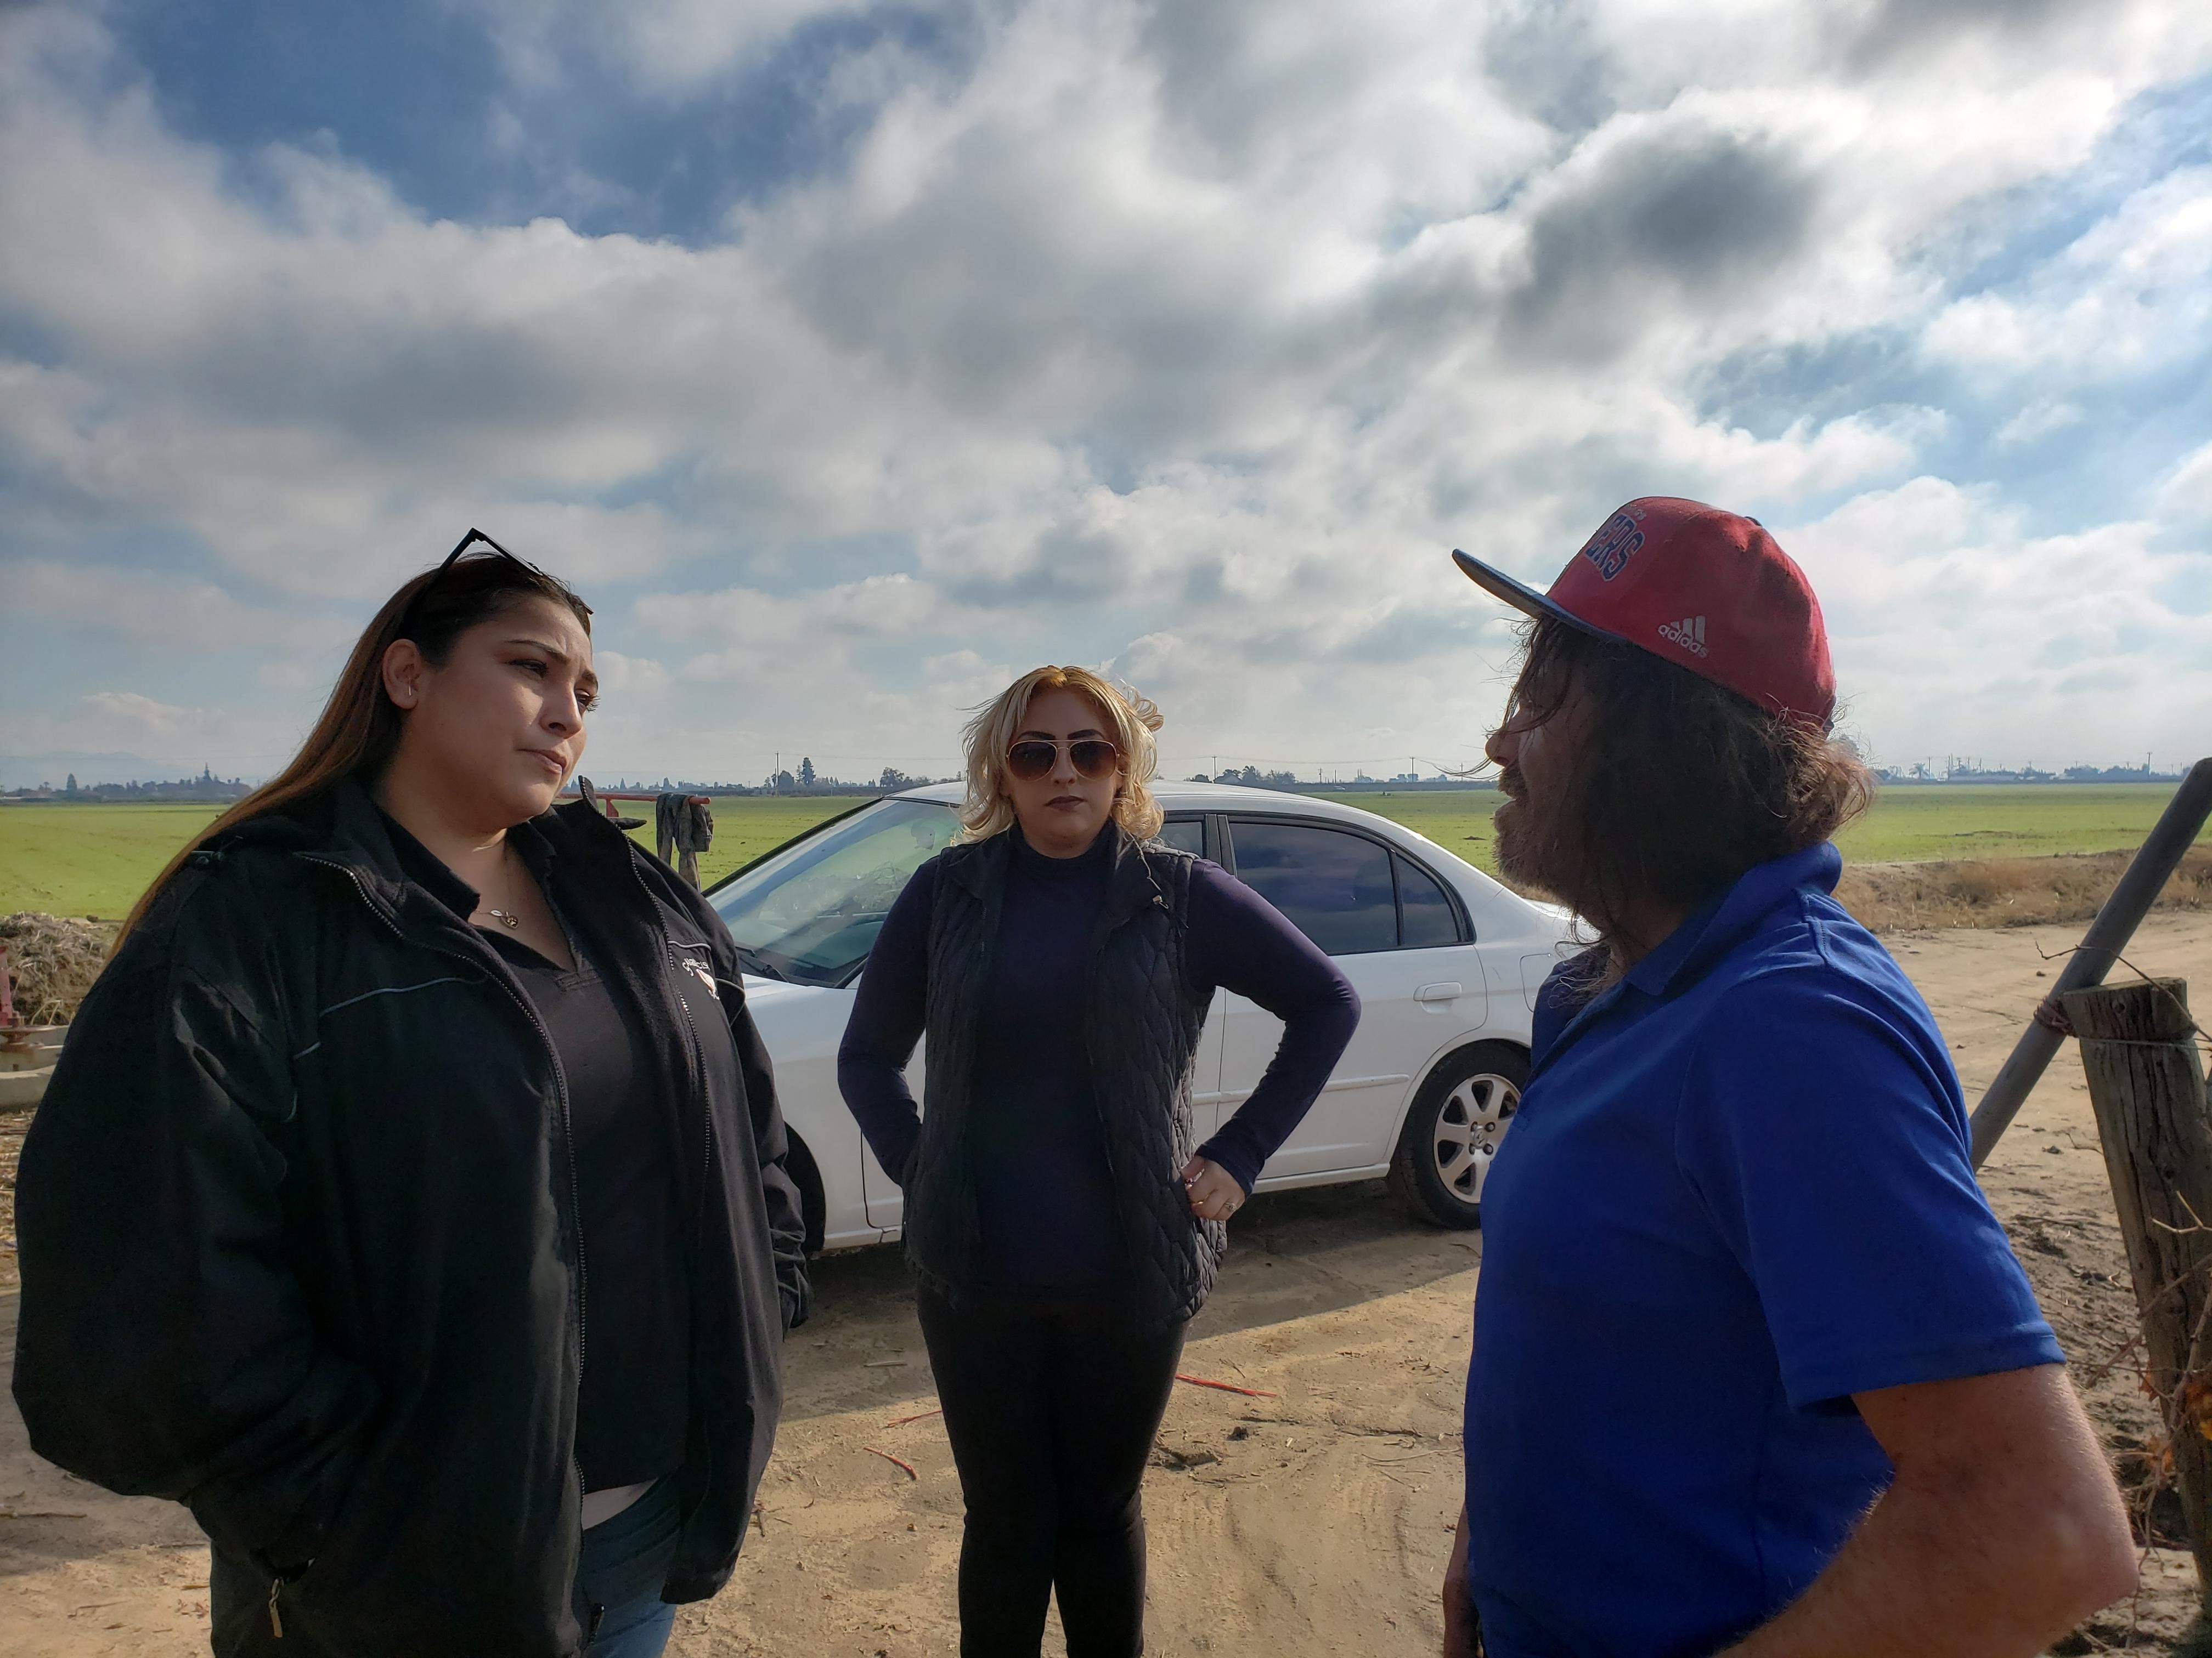
State Funds to the CoC
State Funds with Racial Equity Requirements
California Emergency Solutions and Housing (CESH)
Homeless Emergency Aid Program (HEAP)
Homeless Housing and Assistance Prevention (HHAP) 1, 2, 3, 4, and 5
City of Tulare Encampment Resolution Program (TERP) Round 1 and 2
Investments in:
Housing Development – Tulare and Kings County projects
Rapid Rehousing Projects
Housing Flex Funds
Low Barrier Shelters – Eden House and Porterville Navigation Center
Landlord Mitigation Funds
Increase Outreach Teams and Service Coordination
City of Tulare
KTHA - 2 Housing Navigators
KTHA – 1 Transportation Liaison
Salt + Light – 1 Housing Navigator
Kings View – 1 Housing Navigator
Collaborating with Adventist Health Mobile Health Clinic
Multidisciplinary Team from Tulare County
Clean the World – Mobile shower unit
Rental assistance for up to a year and flex funds

Slide 12
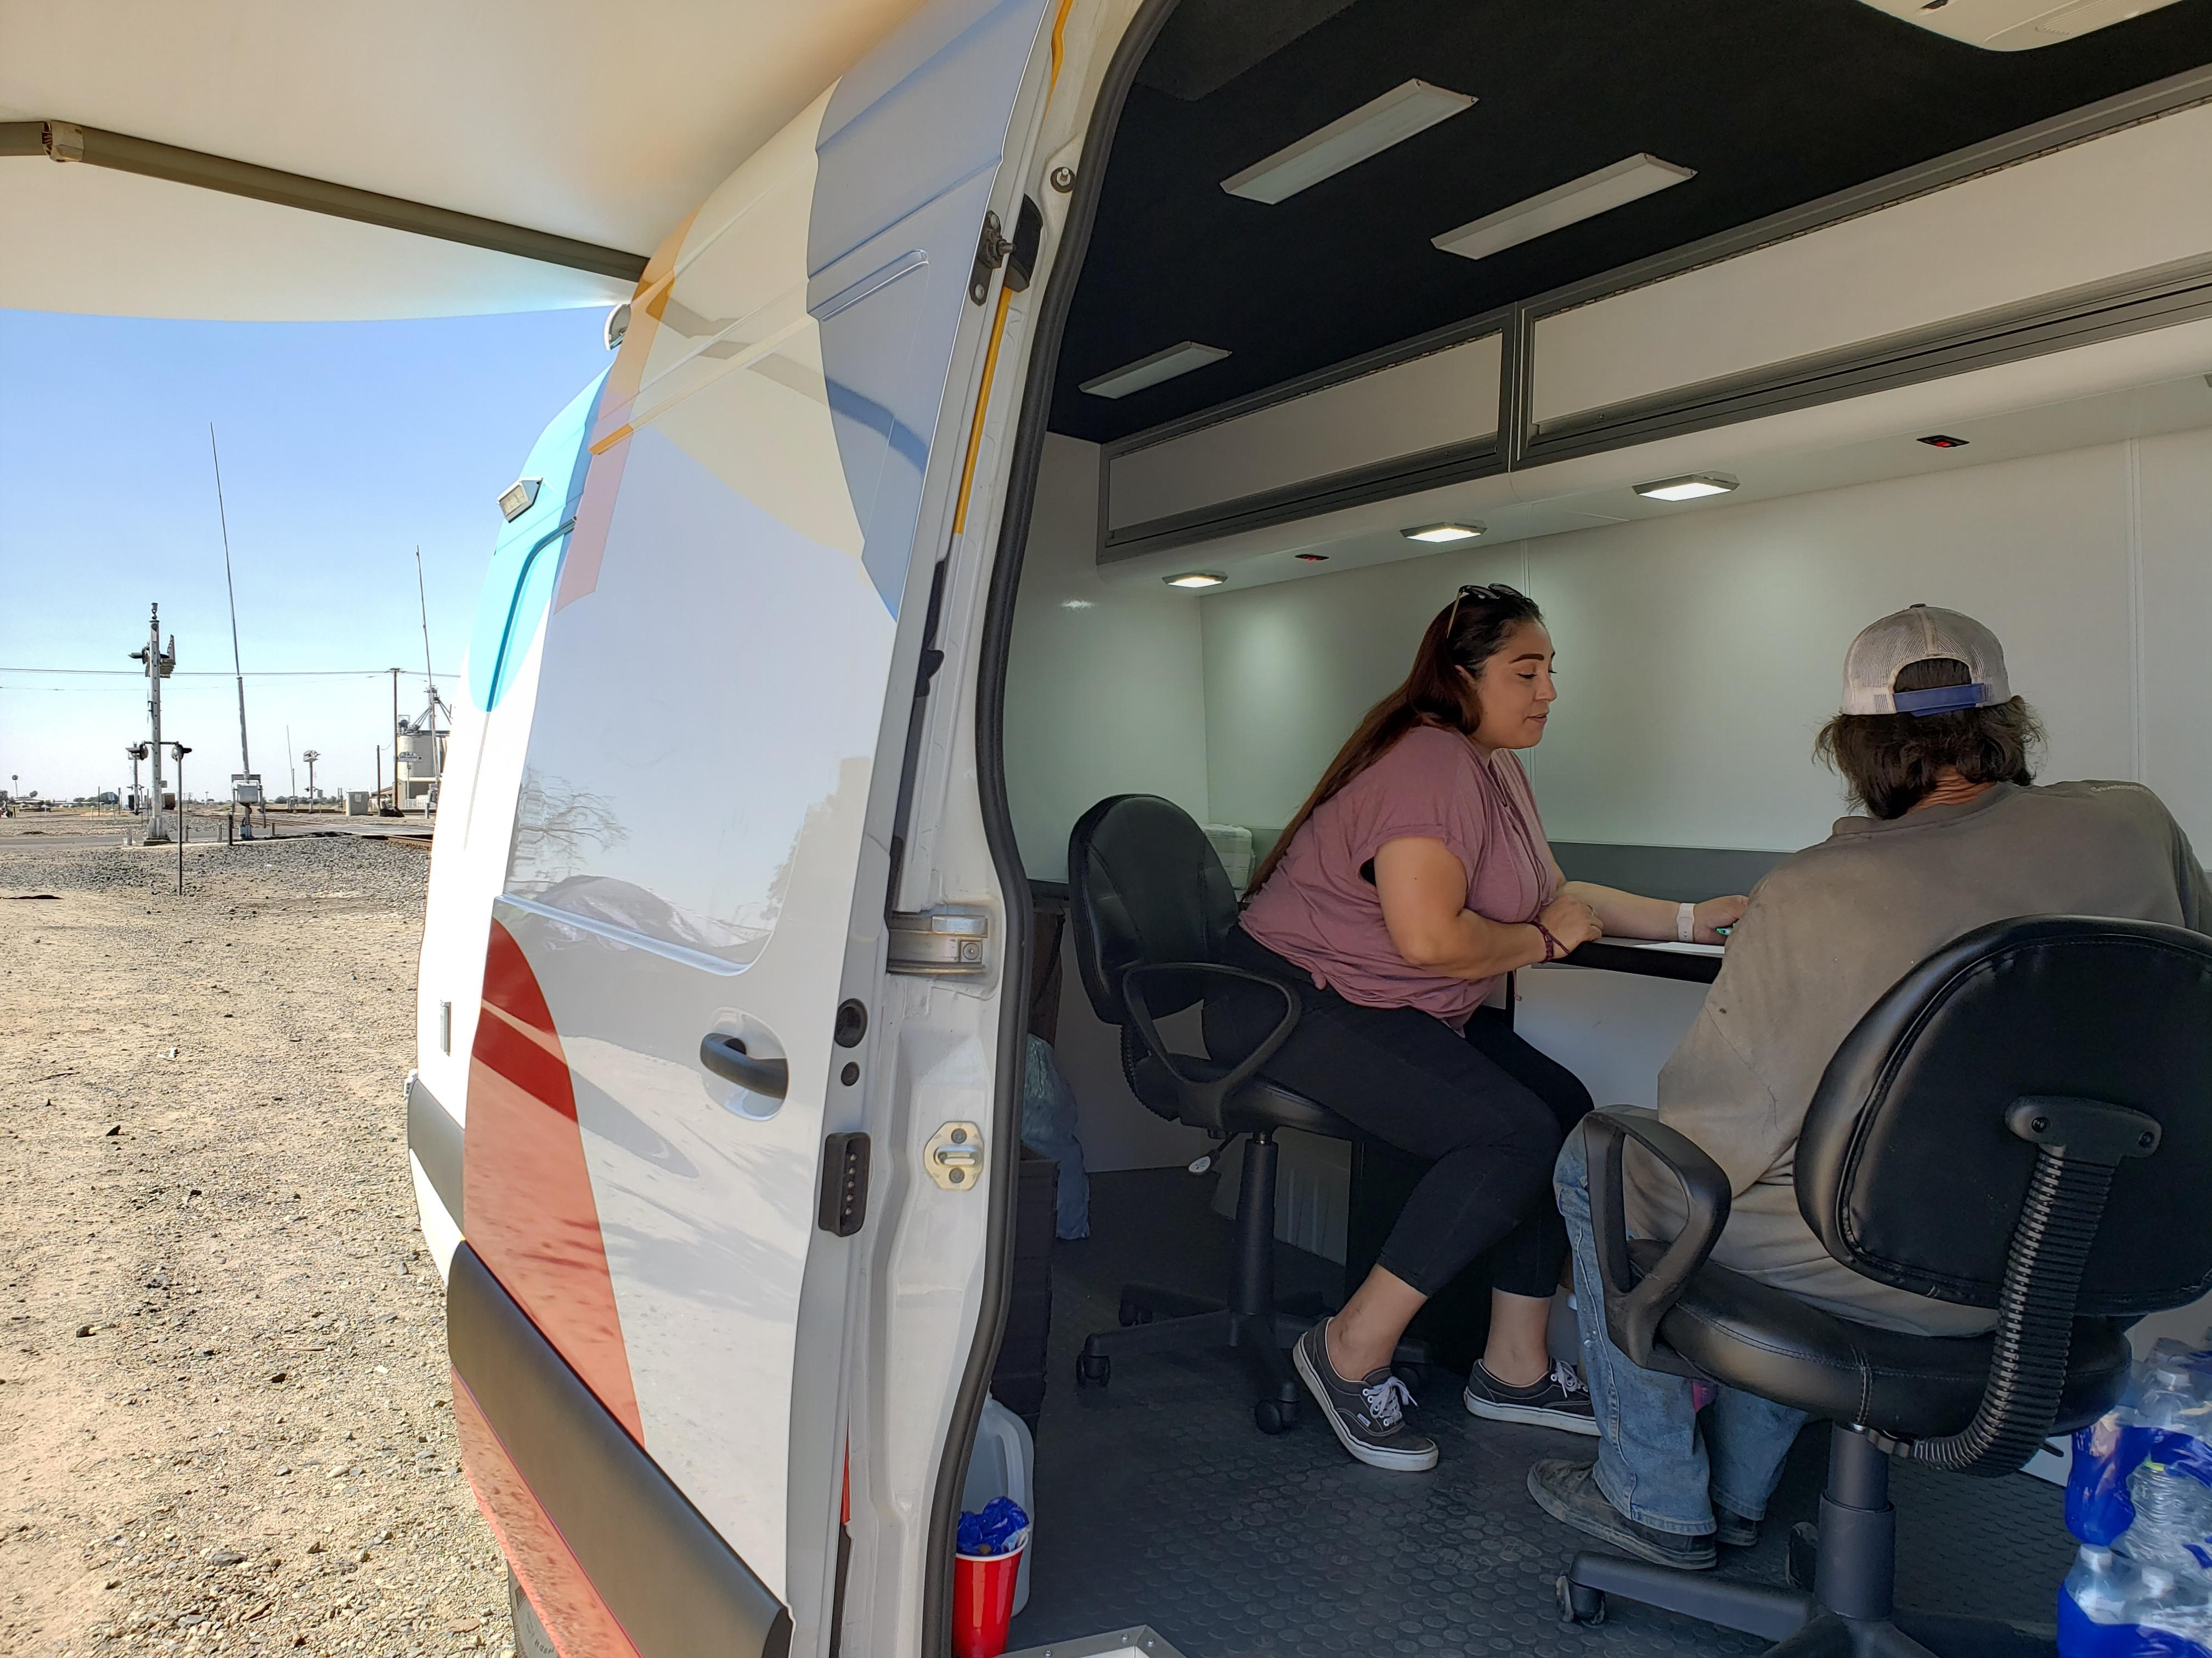
Partnering with Anthem, CalViva, and Health Net of California
HHIP investments
Street Medicine Housing Navigator
Partnering with Kaweah Health and their Street Medicine project
Outreach sprinter van to provide a confidential space, it’s an office on wheels
CalAIM Coordinator
Increase connection between CES and CalAIM ECM and CS service providers.
Training forums to support ECM and CS service providers
Support in CalAIM referrals
Addressing disparities and inequities in housing placements and housing retention
CalAIM in person Convening on a quarterly basis
Landlord Relations Specialist
Racial Equity Coordinator

Slide 13
Updates to Coordinated Entry System
HHIP investments
CES System Wide Mapping in the Bi-County
Integrate CalAIM​ into CES
Look at pressure points and how to lessen those pressure points
Gaps and opportunities for training at monthly bi county case management roundtable and CalAIM in person convenings
HMIS
Train ECM/CS service providers to access HMIS
Data sharing agreements and future alerts on members when there is a housing status change
Total number of referrals/enrollments into CalAIM
Racial Equity Dashboard
Housing Flex Fund
Access
Diversion
Assessment
Prioritization
Referral & Placement

Slide 14
Racial Equity Dashboard
Displays disparities and program performance by race, gender, age, veteran status, and chronic homeless status.
The dashboard analyzes where disparities might exist between race, age, gender:
Length of time in projects
Amount of clients experiencing homelessness
Number of clients who are chronically homeless entering the system
Number of veterans
Number of households with children
Left for permanent housing
Returns to homelessness

Slide 15
Racial Equity Dashboard
The first column shows the first selected race
The second column is a combined total column
The third column shows filtered data for the second selected race

Slide 16
Racial Equity Dashboard Comparing Continued

Slide 17
Next Steps with Racial Equity Dashboard
Identify where there are the greatest inequities in race, gender identity, and sexual orientation, or where underserved populations are located, and target resources to those areas;
Discuss the causes of the disparities. Including historical and continued racial discrimination;
On a routine basis (monthly or quarterly, for example), compare new entries into the homeless system and housing placement data to the general homeless population. Where do disparities continue to occur? What trends can you identify in access? Are those most impacted by racism being served proportionately?
Develop and document adjustments to organizational policies, outreach strategies, prevention, access points, coordinated entry assessments and policies, etc. to address specific and negative impacts identified based on race, gender, sexual orientation, or age.

Slide 18
KTHA Racial Equity Improvement Plan
Key Priorities
System Improvements
Racial Equity Dashboard
Data-Driven Decision Making (DDDM)
People with Lived Experience Committee
Homelessness Expertise at the Table (HEAT)
Young Adults (18-24)
Youth Advisory Board (YAB) in partnership with CSET
LGBTQIA+ Community
Affirm sexual orientation and gender identity (SOGI) inclusivity
2024 HMIS Data Standards
Enter accurate and complete HMIS data
Regional and Programmatic Lexicon
Identity Centered; Client Informed;
and Trauma-Informed

Slide 19
KTHA Racial Equity Plans in Action
Training Courses, Effective date: January 1, 2024
Annual Refresher
Trauma-Informed Care
Harm-Reduction
Compassion Fatigue
Supplemental Courses
(Pending access to funds or fee-waiver)
Safe and Respectful Engagement with Program Participants (OrgCode)
Understanding Unsheltered Homelessness (OrgCode)
Orientation
Housing First Principles
Trauma-Informed Care
Harm-Reduction
Cultural Humility
Yokuts Territory History
Compassion Fatigue
LGBTQIA+

Slide 20
KTHA Racial Equity Plans in Action
Diverse Cultural Perspectives
=
Equitable Sustainability
Youth Action Board (YAB) project development and event planning.
Quarterly hybrid focus groups held in rotating cities across Kings County and Tulare County.
Homelessness Expertise at the Table (HEAT) Committee insight and decision-making voting opportunities.

Slide 21
National Perspective on Equity Centered Strategies
Katie League, Behavioral Health Manager, National Health Care for the Homeless Council

Slide 22
Questions?

Slide 23
Visit CHCS.org to…
Download practical resources to improve health care for people served by Medicaid.
Learn about cutting-edge efforts from peers across the nation to enhance policy, financing, and care delivery.
Subscribe to CHCS e-mail updates, to learn about new resources, webinars, and more.
Follow us on LinkedIn or Twitter @CHCShealth.

