Slide 1
Meeting the Health and Social Needs of LGBTQ+ Older Adults Through Medicaid in California and Nationally
July 18, 2023
2:00-3:00 p.m. ET
Supported by the California Health Care Foundation

Slide 2
Webinar Objectives
Through this webinar, participants will:
Better understand the unique needs and barriers faced by LGBTQ+ older adults related to health, long-term services and supports (LTSS), and social needs.
Discover innovations at the state level that can be used to better address the unique needs of LGBTQ+ older adults who are enrolled in Medicaid.
Learn how California and Massachusetts sought to improve health, LTSS and social care for LGBTQ+ older adults who are enrolled in Medicaid.

Slide 3
Agenda
Welcome and Introductions
Overview of new LTSS and social care initiatives available under California Medi-Cal reform
Overview of the unique health, LTSS, and social needs of LGBTQ+ older adults
Panel Discussion: How Medicaid Can Improve Health, LTSS, and Social Care for LGBTQ+ Older Adults
Moderated Q&A

Slide 4
Welcome & Introductions

Slide 5
Center for Health Care Strategies
Dedicated to strengthening the U.S. health care system to ensure better, more equitable outcomes, particularly for people served by Medicaid.
Together with our partners, our work advances:
Effective models for prevention and care delivery that harness the field’s best thinking and practices to meet critical needs.
Efficient solutions for policies and programs that extend the finite resources available to improve the delivery of vital services and ensure that payment is tied to value.
Equitable outcomes for people that improve the overall wellbeing of populations facing the greatest needs and health disparities.
Notes:
CHCS is a nonprofit based in New Jersey that works with stakeholders nationally to strengthen health care services to ensure better and more equitable outcomes, particularly for children and adults served by Medicaid.
Since 1995, we have worked in every state in the nation. We partner with state and federal agencies, health plans, providers, community-based organizations, and consumers to make health care work better for people who face serious barriers to well-being — barriers like poverty, complex health and social needs and systemic racism.
We work to advance:
More effective models for care delivery;
More efficient policy and program design; and across all our work, we focus on
More equitable care and opportunities to address the obstacles that stand in the way of health equity for people facing the greatest disparities.
Customize the transition to how specific program/presentation supports the above goals…

Slide 6
Today’s Presenters
Carrie Graham, PhD
Director, Long-Term Services and Supports
Center for Health Care Strategies
Jason Flatt, PhD, MPH
Assistant Professor
University of Nevada, Las Vegas
Torshira Moffett, MPH
Senior Program Officer
Center for Health Care Strategies
Kathleen Sullivan, PhD
Executive Director
Openhouse San Francisco
Matthew Phan, MSG
Program Associate
Center for Health Care Strategies
Sean Cahill, PhD
Director of Health Policy Research
Fenway Institute

Slide 7
Medi-Cal innovations: California Advancing and Innovating Medi-Cal (CalAIM)

Slide 8
Goals of CalAIM
CalAIM is a set of multi-year initiatives to transform Medi-Cal to provide whole-person care, address social drivers of health, reduce health disparities, and reduce complexity.
Enhanced Care Management
Community Supports
Institutional Long-Term Care Carve-In
Notes:
Level setting slide for the audience on what CalAIM is.
CalAIM is a far-reaching, multiyear plan to transform California’s Medi-Cal program and to make it integrate more seamlessly with other social services. Led by California’s Department of Health Care Services, the goal of CalAIM is to improve outcomes for the millions of Californians covered by Medi-Cal, especially those with the most complex needs.

Slide 9
Enhanced Care Management
Became a required Medi-Cal benefit in 2022
Medi-Cal managed care plan provide the service to all Medi-Cal beneficiaries who:
Are part of a “population of focus” identified under CalAIM:
2022 – People experiencing homelessness, at risk for avoidable hospitalizations, serious mental Illness or substance use disorders, transitioning from incarceration, adults with IDD, adults who are pregnant or postpartum
2023 – Adults at risk for LTC institutionalization, nursing home residents transitioning to the community.
Meet the eligibility requirements (high acute care utilization, SNF level of care)
5 or more ED visits
Requires plans to contract with external community-based organizations (CBOs) that assess eligibility and provide services.
Notes:
Designed based on learnings from the care management approaches implemented by some counties through the Whole Person Care demonstrations, Health Home demonstrations, and Coordinated Care Initiative.

Slide 10
Community Supports (In Lieu of Services)
Became an “optional” Medi-Cal benefit in 2022
Medi-Cal managed care plans can optionally provide any of 14 services:
Housing transition, navigation, housing deposits, housing tenancy
Short-term post hospitalization housing, recuperative care, respite services.
Nursing facility transition/diversion to assisted living
Personal care/homemaker services
Home modification
Medically supportive food/medically tailored meals
Medi-Cal beneficiaries must be part of a “population of focus” and meet eligibility requirements.
Like Enhanced Care Management, plans contract with external CBOs to assess eligibility and provide various Community Supports

Slide 11
Long-Term Care Carve In
Beginning in 2022 all Medi-Cal managed care plans began “carving in” nursing home care and other institutional care.
About half of California counties were already carving in nursing home care, while about half are newly doing so.
Plans must contract with a provider network of nursing homes and other institutions.
Medi-Cal plans can leverage Enhanced Care Management and Community Supports and other Medi-Cal services and supports to ensure that members are transitioned out of institutional care into more community-based settings as much as possible.

Slide 12
Current Protections for LGBTQ+ Older Adults in Long-Term Care (LTC) Facilities
Federal 1987 Nursing Home Reform Law requires every nursing home with Medicaid or Medicare funding to “protect and promote the rights of each resident” emphasizing individual dignity and self-determination in the provision of long-term care.
Several states recognizing “families of choice” for paid caregiving leave (CA, NJ, OR, MA)
California 2017 LGBT LTC Facility Residents’ Bill of Rights makes discriminatory actions a crime (i.e., denying care, assigning residents to rooms that do not match their gender identity, prohibiting certain residents from sharing a room, restricting visitors based on gender or legal relationship). Requires facilities to:
Post a specified notice about LGTBQ+ discrimination in all places where its current discrimination policy is posted
Include gender identity, preferred name, and pronouns indicated by residents on intake records and address all residents with those names/pronouns
Protect personally identifiable information regarding sexual orientation, gender transition history, and HIV status
Gives protections related to bodily privacy during medical care
https://theconsumervoice.org/uploads/files/general/sb_219_88_C_bill.pdf
https://californialgbtqhealth.org/resources/faqs/
Notes:
https://theconsumervoice.org/uploads/files/general/sb_219_88_C_bill.pdf
https://californialgbtqhealth.org/resources/faqs/

Slide 13
Addressing the Health Care and Social Service Needs of LGBTQ+ Older Adults

Slide 14
Addressing the Health Care & Social Service Needs of LGBTQIA+ Older Adults
Jason Flatt, PhD, MPH
Assistant Professor
University of Nevada, Las Vegas
Pronouns: He/They
Notes:
Thanks to Christian Magno & Pooja Bhour for the art

Slide 15
OUR TIME TODAY
Terminology
Why Inclusion Matters!
Research on LGBTQIA+ Health Care & Social Service Needs

Slide 16
Notes:
Before we get started, I wanted to brief you on some terminology that you may not be familiar with.
I introduced the talk today as ‘the health of LGBTQIA+ older adults and their caregivers’. And some of you might be unsure of what exactly I am referring to when I say LGBTQIA+, right?
So, if you look at this illustration, you can easily see that L stands for lesbian – pretty self explanatory. Same with the G, and the B. But then you get to T, and you see that T can represent two identities: transgender and transsexual. Similarly, with Q, and A.
I promise I am not trying to confuse you! What I am trying to communicate, is that the terminology associated with these populations is not perfect, nor is it stagnant. In fact, these terms have and will continue to evolve and change over time, and there are generational patterns in terminology that are used. For example, older adults are more likely to use transsexual than younger adults who would likely use transgender.
And the + sitting on the end of LGBTQIA, symbolizes all the other terms, which may not be captured here on in this illustration.
For brevity sake, you may hear or see the term “Sexual and gender minority” or (SGM), which is another umbrella term used by the National Institutes of Health, and largely in an academic context (less so in the community itself), that encompasses lesbian, gay, two-spirit, bisexual, and transgender populations as well as those whose sexual orientation, gender identity and expressions, or reproductive development varies from traditional, societal, cultural, or physiological norms. This includes individuals with differences of sex development (DSD), also described as intersex.

Slide 17
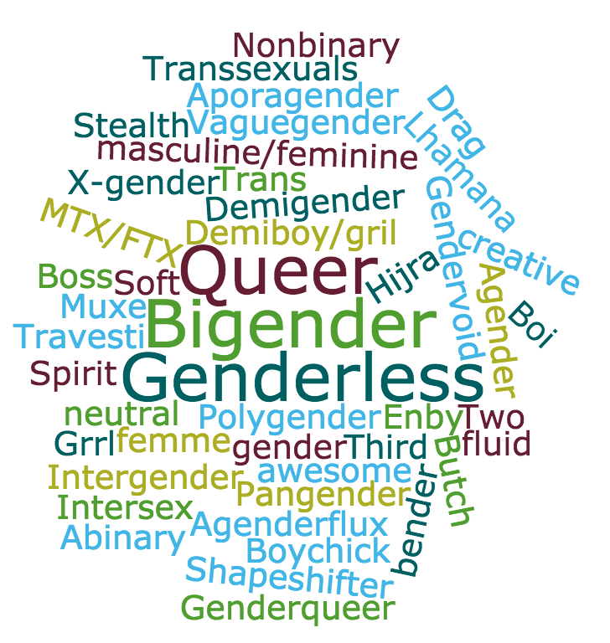
Notes:
Gender identity – one’s sense of being a man, woman, both, transgender, or some other identity, which may or may not correspond with the sex one is assigned at birth.
Can identify with any sexual orientation
Diverse subpopulations, Understudied and underrepresented in health-related research
Some older individuals may identify as a transsexual and not endorse being transgender. Middle to older aged GM identify more within binary distinctions (transgender man or woman) whereas younger adults are using multiple terms to describe their gender and gender identity and are more likely to identify along a gender spectrum (transfeminine)
GM adults represent a substantial portion of the population, about the same number of people who live in Hawaii or that reside in Phoenix, Az. This is not a small population.

Slide 18
Why Inclusion Matters!
Notes:
Division of Neuroscience’s webinar series, “Minority Health and Health Disparities Research in Neuroscience.

Slide 19
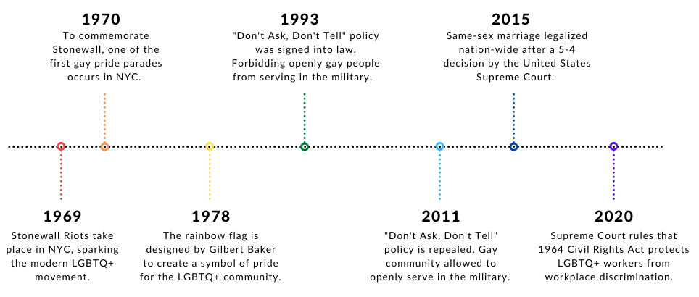
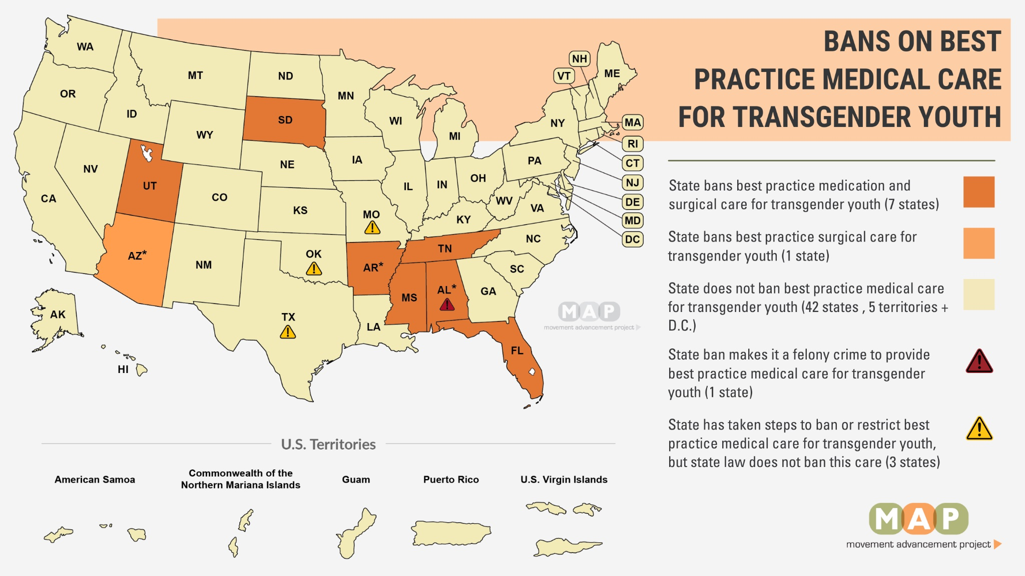
DSM: Historical & current pathologizing of sexual orientations (1973) & gender dysphoria/gender identity disorder (2013)
1947 Sex Perversion Elimination Act, Lavender Scare, 1969 Stonewall Riots, HIV/AIDS epidemic, The Equality Act, Growing Anti-Transgender Legislation & Hate Crimes
Lack protections for basic human rights (e.g., housing, employment, healthcare)
Intersecting & compounding effects of discrimination for intersecting marginalized identities (SGM status + racial/ethnic minority, serostatus, disability)

Slide 20
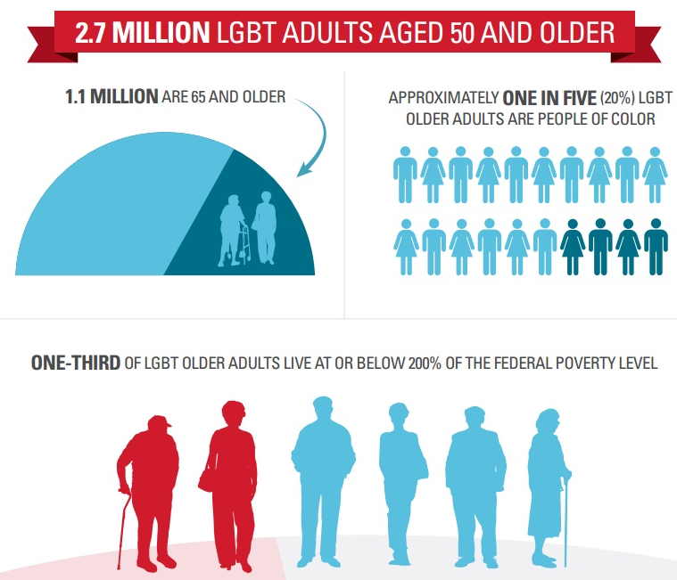
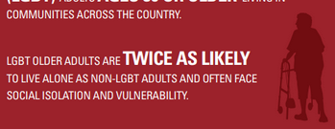
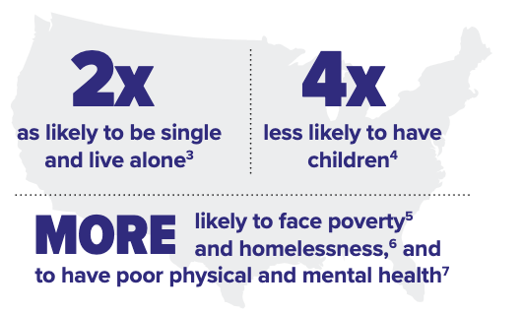
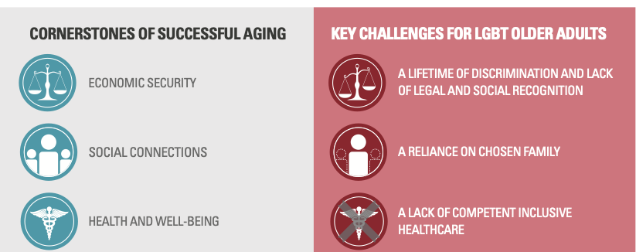
Notes:
Lack of opportunities & legal protections for basic human rights (e.g., housing, employment, healthcare)
Historical & current pathologizing of non-heterosexual sexual orientations (1973) & gender dysphoria/gender identity disorder (2013) in DSM
1947 Sex Perversion Elimination Act, Lavender Scare, 1969 Stonewall Riots, HIV/AIDS epidemic, The Equality Act, Growing Anti-Transgender Legislation & Hate Crimes
Intersecting & compounding effects of discrimination due to having intersecting marginalized identities (SGM status + racial/ethnic minority, serostatus, disability)

Slide 21
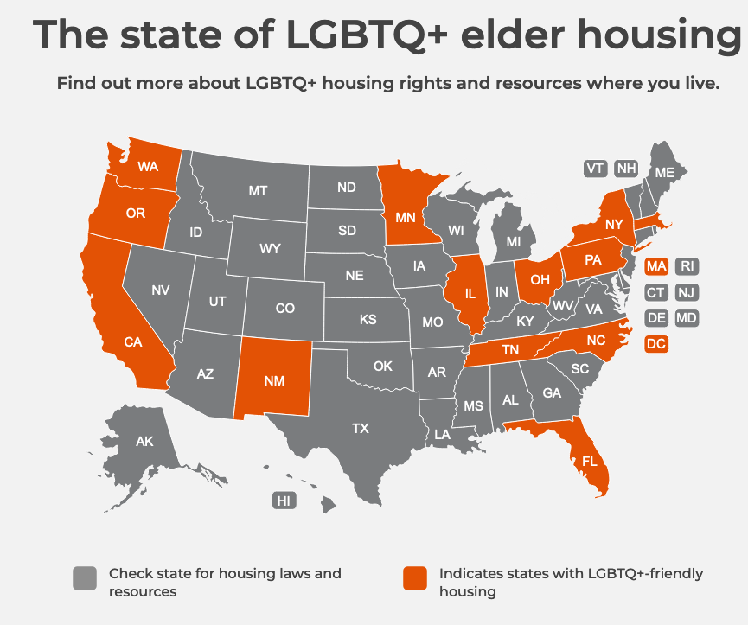
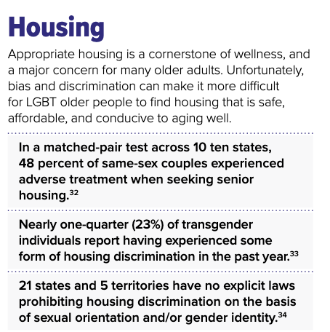

Slide 22
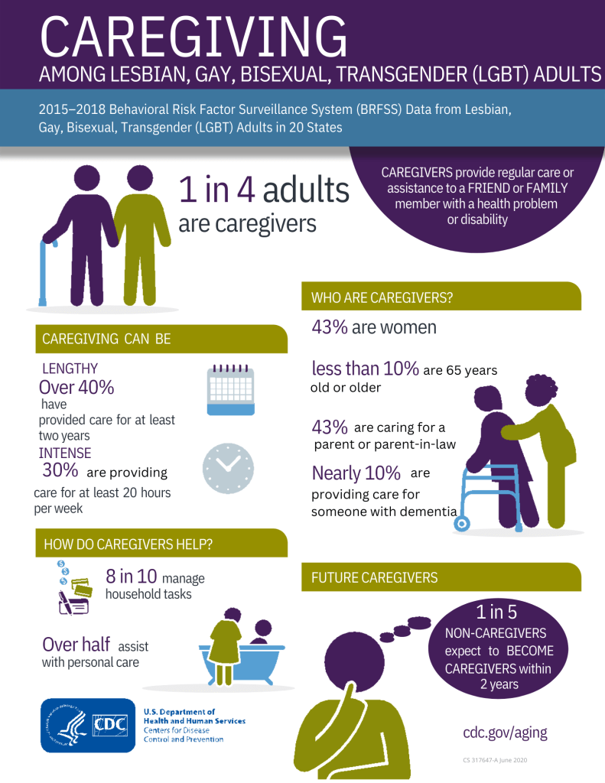
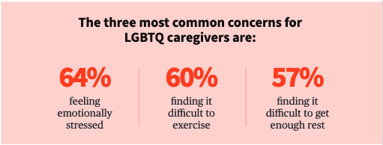

Slide 23
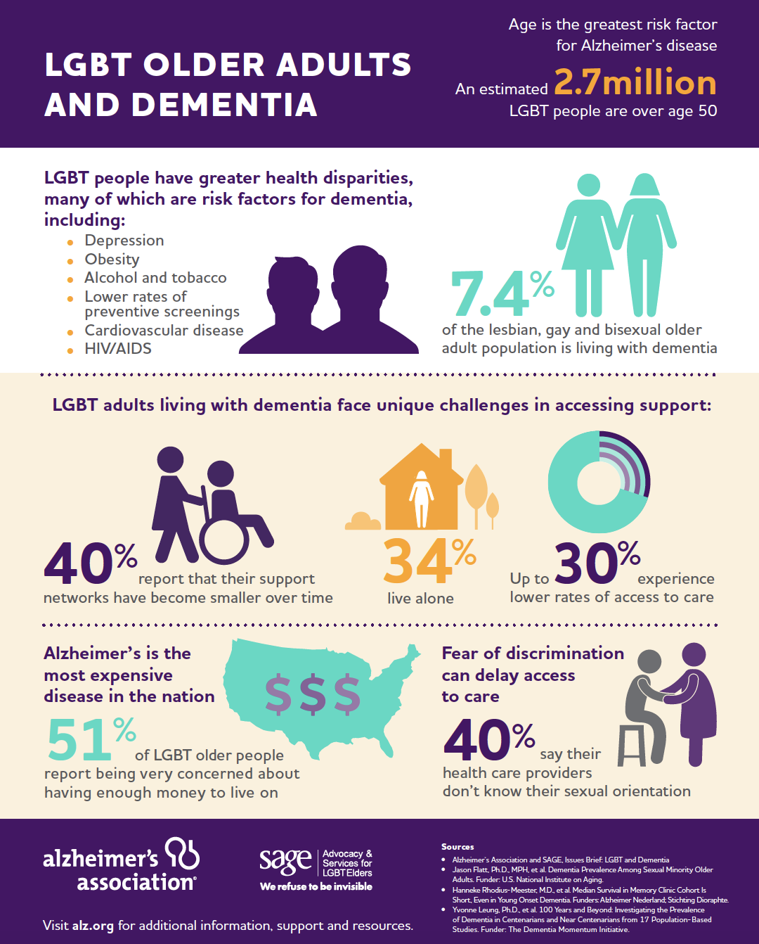
Flatt et al (2022)
17%
Minoritized Ethnoracial Transgender
22%
White Transgender
15%
White Cisgender
9%
Notes:
Cognitive Impairment
2015-2018 U.S. Behavioral Risk Factor Surveillance System - 25 States
Subjective Cognitive Decline: “During the past 12 months, have you experienced confusion or memory loss that is happening more often or is getting worse?”

Slide 24
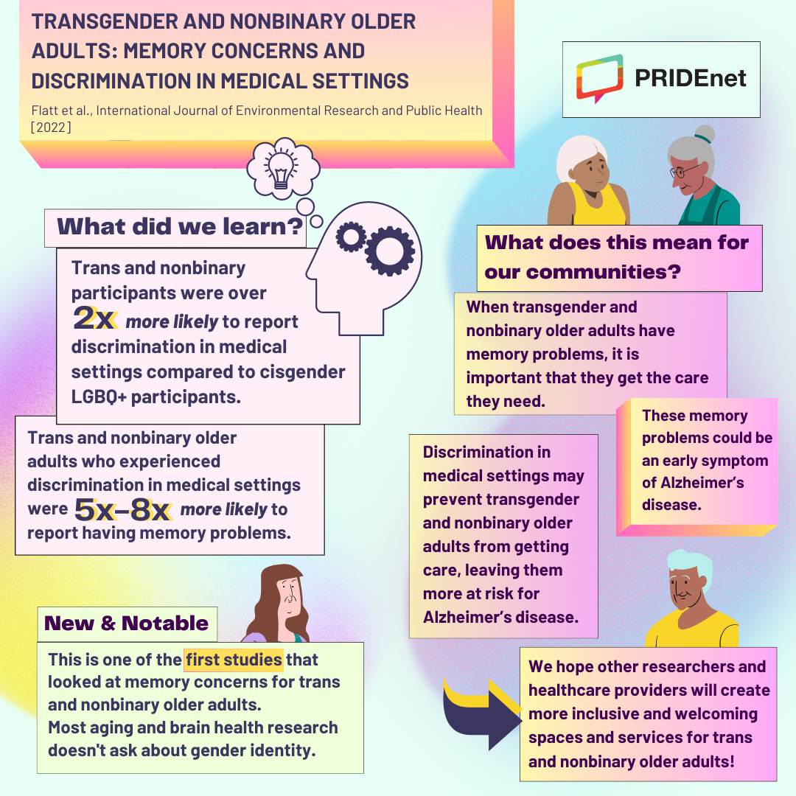
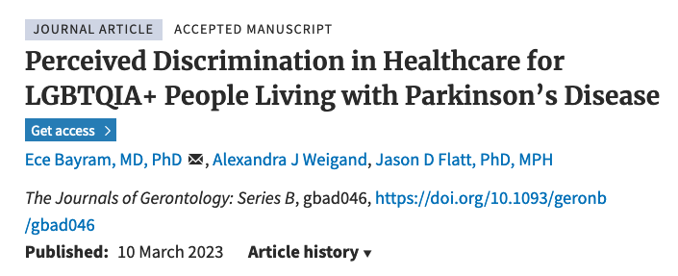
LGBTQIA+ people living with Parkinson’s disease reported highest frequency of perceived discrimination in healthcare
Discrimination higher for cisgender, heterosexual women and LGBTQIA+ people living with PD compared with cisgender, heterosexual men

Slide 25
We need greater representation of LGBTQIA+ elders
Promote resilience, training in cultural humility, consider trauma- informed care approaches, & give back!
LGBTQIA+ discrimination in health care, service, housing, jobs, etc is a major concern for elders
More affordable & welcoming housing development
Advocacy: Support S caregivers, families of choice, and ensure inclusive services for all people
Address LGBTQIA+ elders unique health & social needs

Slide 26
Acknowledgements
This work is supported by the National Institutes of Health, National Institute on Aging (K01AG056669; R24AG066599; P30AG015272), Alzheimer’s Association & Michael J. Fox Foundation
The content is solely the responsibility of the author & does not necessarily represent the official views of the National Institutes of Health
No conflicts of interest to report

Slide 27
Thank you! Questions? Email: Jason.Flatt@unlv.edu www.RainbowsofAging.org

Slide 28
Panel Discussion: How Medicaid Can Improve Health, LTSS, and Social Care for LGBTQ+ Older Adults
Notes:
Moderated by Matthew

Slide 29
MEDICAID/-care especially important for people living with HIV, transgender people
40% of non-elderly PLWH are on Medicaid, compared to 15% of the general population not living with HIV
More likely to be dual eligible, qualify based on disability than the general Medicaid population
Dawson L, Kates J, Roberts T, Chidambaram P, Medicaid and People with HIV, Kaiser Family Foundation, March 27, 2023
Many transgender, LGBTQ people are on Medicaid
2017 CMS OMH analysis of transgender people on Medicare found they were more likely to qualify based on disability, and have multiple chronic conditions
Dragon CN, Guerino P, Ewald E, Laffan AM. LGBT Health. 2017 Dec;4(6):404-411.

Slide 30
MASSACHUSETTS State policy innovations
Nation’s first statewide LGBT aging commission, the Special Legislative Commission on LGBT Aging (2014-present) (Illinois has one too since 2022)
Executive Office of Elder Affairs designated LGBT older adults a population of greatest social need under OAA in 2012
Executive Office of Elder Affairs collecting sexual orientation and gender identity (SOGI) data from clients since 2016
2018 law mandates that all elder service providers be trained in LGBT cultural competency

Slide 31
MASSHealth 1115 waiver
$2B incentive program over 5 yrs to “hold ACOs and ACO-participating hospitals accountable for reducing disparities in health care quality and access. Providers will improve data collection and reporting on demographic and social risk factors such as…[SOGI]; implement evidence-based clinical interventions to improve quality and access; and receive incentive funding for performance on improving quality and reducing disparities.” – Sept. 2022
https://www.mass.gov/doc/1115-waiver-extensionfact-sheet/download

Slide 32
Questions?

Slide 33
Questions?
To submit a question online, please click the Q&A icon located at the bottom of the screen.

Slide 34
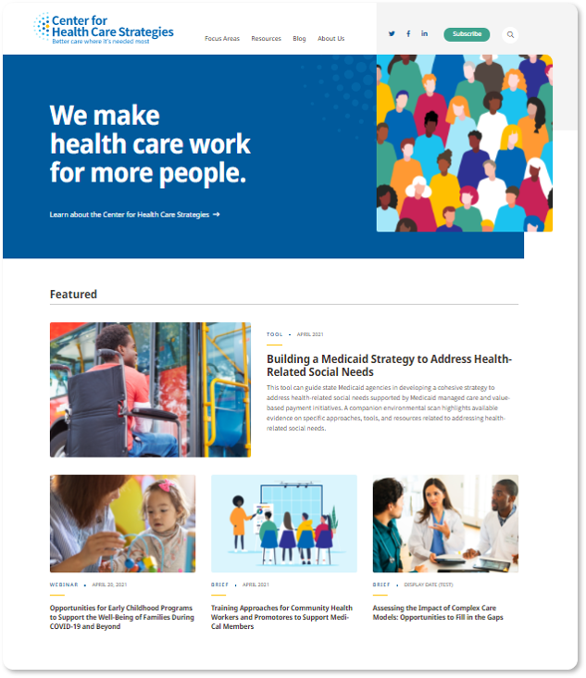
Visit CHCS.org to…
Download practical resources to improve health care for people served by Medicaid.
Learn about cutting-edge efforts from peers across the nation to enhance policy, financing, and care delivery.
Subscribe to CHCS e-mail updates, to learn about new resources, webinars, and more.
Follow us on Twitter @CHCShealth.

